Slide 1
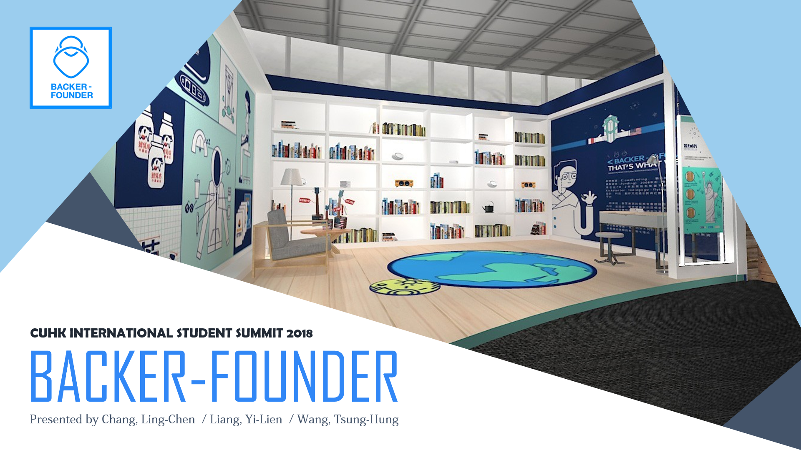

Slide 2


Slide 3

Background: Backer-Founder
Backer-Founder is the first and only crowdfunding consultancy in Taiwan.
Reality show
Technology gadget
Fields
Social good
Founder : Lin, Da-Han
Handcrafts design
Founded in October 2014
Games production

Slide 4





Background: Services
BACKER-FOUNDER
BACKME
CROWD WATCH
Consulting
Market Promotion
Copy Editing
Cash-flow Service
On-line Connection
Diary of Crowdfunding
View of Crowdfunding
BACKHOUSE
BACKWORK
Organization of Activity
Space Rental Service
MOO Limited Shop
Filming & Design

Slide 5

Background: The Importance of the Start-up “Backer-Founder”
1.
Introducing crowdfunding to the Taiwanese
2.
Decrease the risk of default

Slide 6
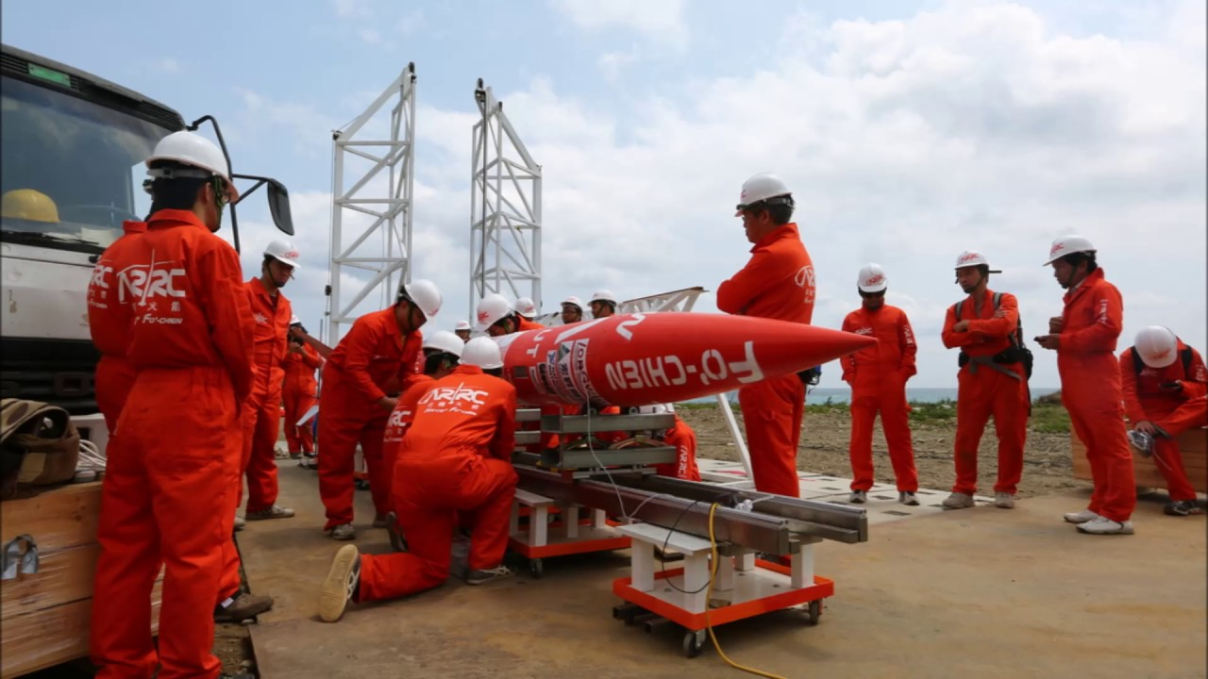
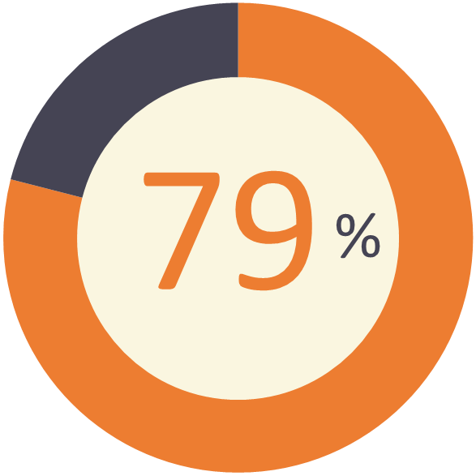

Classic Case: The Background of the ARRC
The ARRC Rocket
Outcome
Brings great impacts
on the high-end technology.
The professionals
will be taken seriously by
the private and government.
NT$ 12,676,430 / NT$ 16,000,000
≃US$ 423,295 / US$ 534,277

Slide 7
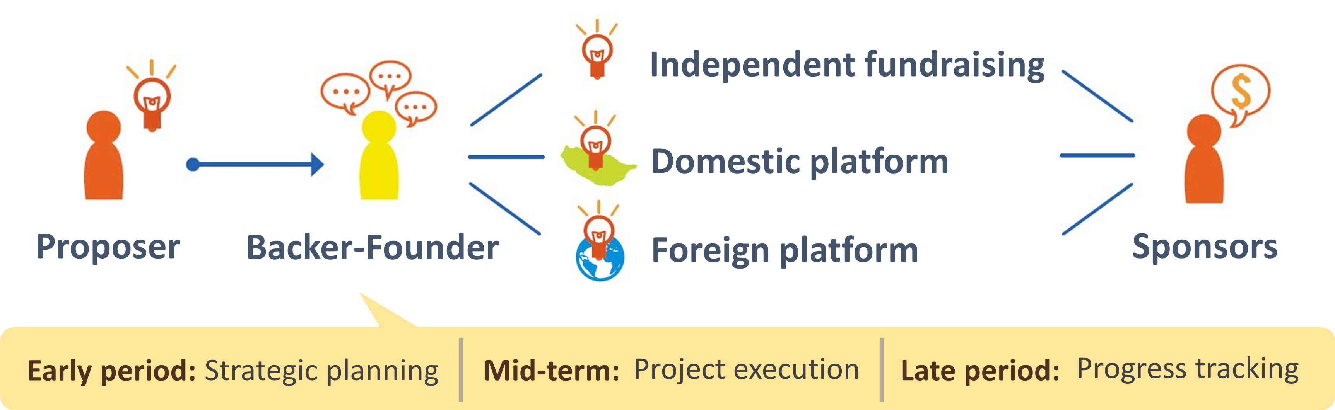
Business Model

Slide 8


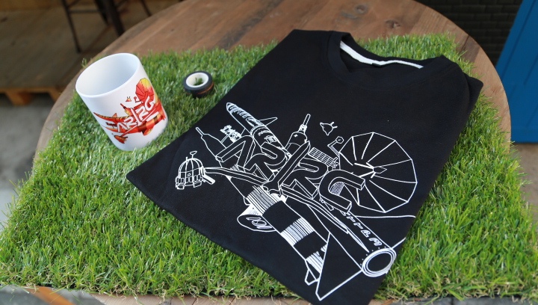
Classic Case: The Business Model of ARRC
Cash-flow service
Independent fundraising website
BackMe
Project planning
Launch Delay
Type of fundraising
Rewards
Backer-Founder
BackWork
Simpleinfo
Copy design
Advertising
Rewards

Slide 9

Sources of Profit
A project production fee depending on the project content.
A 10~15% of commission for each project.

Slide 10


Slide 11




Economic and Social Impacts on the Local Community
Bring uncommon culture and sub-culture to the public and the government sector.
Raised public awareness toward valuable Taiwanese arts and humanities.
Creators are encouraged to bring their products from concepts to reality.

Slide 12

Economic and Social Impacts on the Greater Community
Market-based finance is an alternative to traditional lending.
Help novel business models occur and stimulate economic growth.
Provide a new product for portfolio diversification and a new mind to the people.

Slide 13


Slide 14


Government Policy: Facilitating Policies
Regulatory Sandbox
Entrepreneurs are able to experiment their products in the markets.
Fewer policy constraints during experiment period.
Frequent interaction between the start-ups and the policy maker.
Amendment of Company Law
Credits and services have capital values and can be transferred.
Introducing no-par value stock.

Slide 15



Government Policy: Hindering Policies
The Taiwanese government is strict with foreign investment and immigration.
Some new start-ups with avant-garde insights are prohibited by the government.
Non-authorization account cannot transfer more than 30,000 N.T.D. (≃1,000U.S.D) within a day.

Slide 16


Slide 17
Recommendation: Cooperate with Different Experts
BENEFIT
Maintain Backer-Founder’s uniqueness.
Market testing and market validation can be initiated in advance.
Risk of fraud could be greatly decreased.
Risk of default could be avoided.
Reduce product development costs.
COST
Personnel expenses may increase.
Industrial espionage may occur.

Slide 18

Recommendation: Collaborate with Live-Streaming Platforms
Increase Backer-Founder’s and fundraisers’ exposure to the public.
Up-to-date market research needed to be done regularly, which may cause extra cost.
The interactive feature of live-streaming create a channel of direct communication.
Intellectual property rights of business ideas need to be concerned.

Slide 19

References
Executive Yuan, Republic of China (Taiwan) (n.d.). Retrieved April 23, 2018, from https://www.ey.gov.tw/
Financial Supervisory Commissions R.O.C. (Taiwan) (n.d.). Retrieved April 23, 2018, from https://www.fsc.gov.tw/ch/index.jsp
Jung, Eun Ju, Anjana Susarla and Vallabh Sambamurthy. 2014. Evolutionary Fundraising Patterns and Entrepreneurial Performance in Crowdfunding Platforms (Research-in-Progress). ICIS 2014 Auckland.
Kirby, Eleanor and Shane Worner. 2014. Crowd-funding: An Infant Industry Growing Fast. IOSCO.
Lee, Tae-heon and Hee-Woong Kim. 2015. An Exploratory Study on Fintech Industry in Korea: CrowdfundingCase. 2nd International conference on Innovative Engineering Technologies (ICIET).
Mollic, Ethan. 2014. The dynamics of crowdfunding: An exploratory study. Journal of Business Venturing.

Slide 20



